Slide 1

CPRG 307 Slides are part of the Instructor Resources for the course required textbook and are provided with permission from the publisher:
Oracle 11g: PL/SQL Programming
Joan Casteel
978-1-133-94736-3
Course Technology (Cengage Learning)
Oracle11g :
PL/SQL Programming
Chapter 6
Functions

Slide 2
Introduction to Functions
A function is similar to a procedure in that it can accomplish a task and retrieve/return values
A function is part of an expression, not an entire statement such as a procedure
Can be used in both PL/SQL and SQL statements
Same as Oracle-supplied functions (ROUND, TO_CHAR)
Contains a RETURN statement
Oracle11g: PL/SQL Programming

Slide 3
Example of Oracle-Supplied Function
SQL
SELECT idProduct, price, ROUND(price, 0)
FROM bb_product
WHERE idProduct < 4;
PL/SQL
  DECLARE
  v_amt1 number(5,2);
  v_amt2 number(3,0);
  BEGIN
  v_amt1 := 32.50;
  v_amt2 := ROUND(v_amt1,0);
  DBMS_OUTPUT.PUT_LINE(v_amt2);
  END;
Oracle11g: PL/SQL Programming

Slide 4
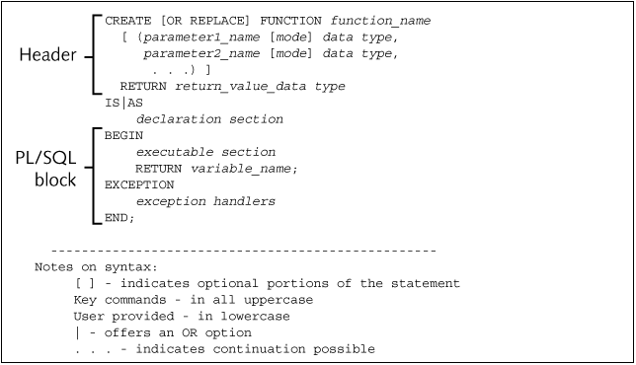
Function Create Statement
Oracle11g: PL/SQL Programming

Slide 5
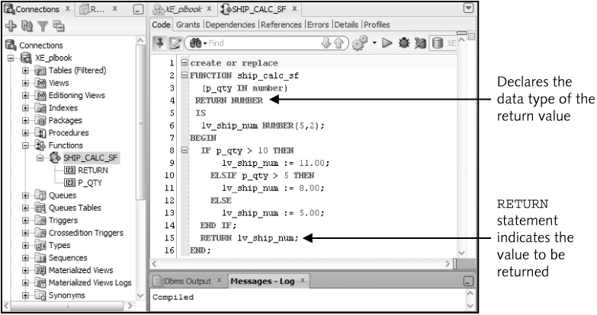
Function Example
Oracle11g: PL/SQL Programming

Slide 6
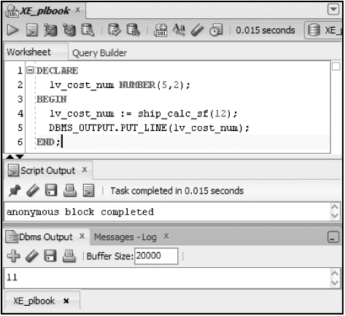
Invoking a Function from a Block
An assignment statement is used – a function RETURNS a value!
Oracle11g: PL/SQL Programming

Slide 7
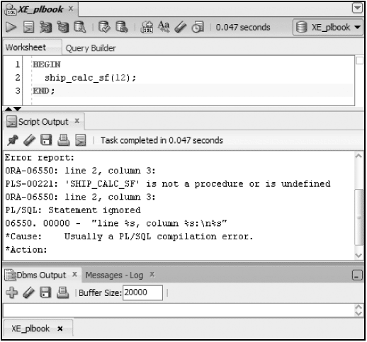
Attempt to Invoke Stand-alone
Oracle11g: PL/SQL Programming

Slide 8
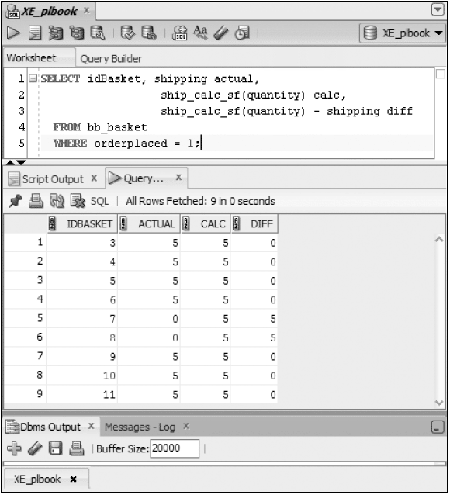
Use Function in SQL
Oracle11g: PL/SQL Programming

Slide 9
Brewbean’s Member Display
CREATE OR REPLACE FUNCTION memfmt1_sf
(p_id IN NUMBER,
p_first IN VARCHAR2,
p_last IN VARCHAR2)
RETURN VARCHAR2
IS
lv_mem_txt VARCHAR2(35);
BEGIN
lv_mem_txt := 'Member ' || p_id || ' - ' || p_first
|| ' ' || p_last;
RETURN lv_mem_txt;
END;
Oracle11g: PL/SQL Programming

Slide 10
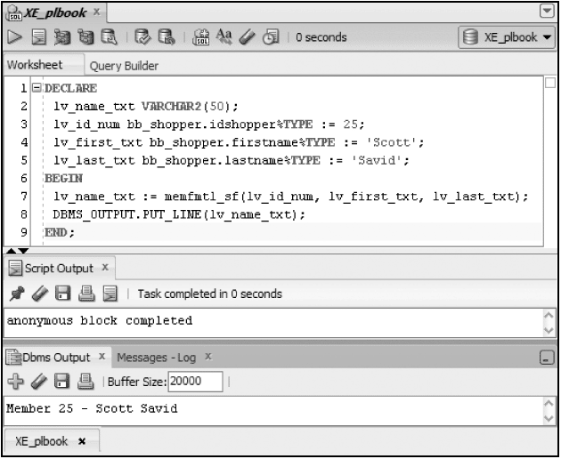
Member Display Test
Oracle11g: PL/SQL Programming

Slide 11
Using OUT Mode in a Function
OUT parameters are not typically used in functions, as:
  Mixing OUT and RETURN values can lead to confusion
  It prohibits the function from being used in SQL
Oracle11g: PL/SQL Programming

Slide 12
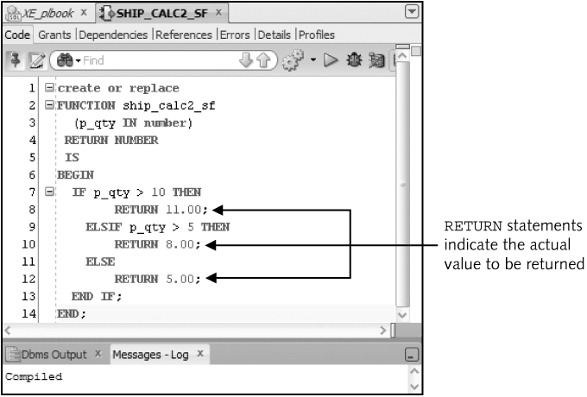
Multiple RETURN Statements
Note: Only one RETURN statement can execute
Oracle11g: PL/SQL Programming

Slide 13
RETURN Statement in a Procedure
Different purpose than a RETURN statement in a function
Used to change flow of execution
Stops processing in that block and moves to the next statement after the procedure call
Stand-alone statement with no arguments
Should NOT be used in a procedure
Oracle11g: PL/SQL Programming

Slide 14
Parameter Constraints
Formal parameters – included in a program unit
Actual parameters – arguments used in a program unit call
Argument for an OUT parameter must be a variable to hold the value returned
Actual parameters determine the size of the formal parameters
Oracle11g: PL/SQL Programming

Slide 15
Passing Parameter Values
Two techniques used to pass values between actual and formal parameters:
  Passed by Reference – create pointer to
  value in the actual parameter
  Passed by Value – copies value from
  actual to formal parameter
Pass by value is the default
Use a compiler hint to use pass by reference
Oracle11g: PL/SQL Programming

Slide 16
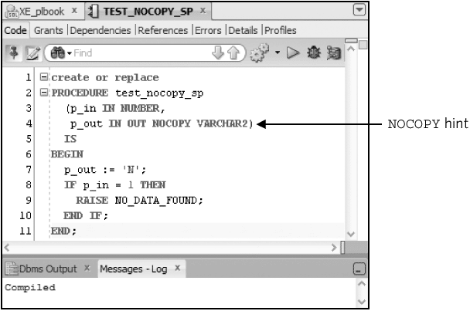
Pass by Reference
Oracle11g: PL/SQL Programming

Slide 17
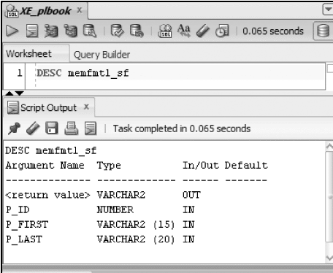
Data Dictionary Information
DESCRIBE identifies parameters and return value data type
Oracle11g: PL/SQL Programming

Slide 18
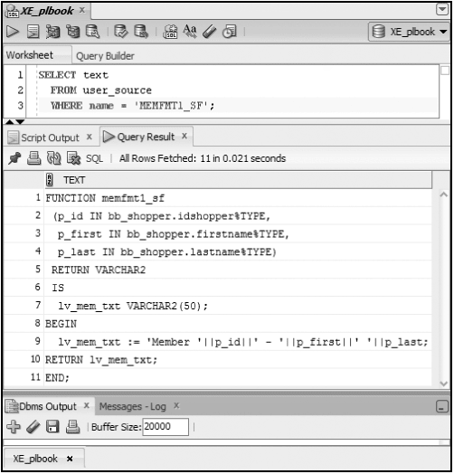
Data Dictionary Information (continued)
View source code using USER_SOURCE
Oracle11g: PL/SQL Programming

Slide 19
Delete Functions
DROP FUNCTION function_name;
Oracle11g: PL/SQL Programming

